Slide 1
AAI integration use case for the EGI Jupyter Notebook service
Giuseppe La Rocca EGI Foundation

Slide 2
The EGI Notebooks
Offer Jupyter notebooks ‘as Service’
One-click solution, just login and start using
Extra EGI Features:
Login with the EGI AAI Check-In service
Persistent storage for notebooks
Bring your own environments/kernels
Use EGI computing and storage resources from your notebooks

Slide 3




EGI AAI Check-In service
Federated Identity Access Management (IAM) solution for research communities.
Combines multi-protocol federated access and flexible group/Virtual Organization management capabilities in one single platform.
Designed to enable users to transparently access distributed federated service providers.
Minimize overhead for end users, communities and service providers.
Implements the AARC Blueprint
Identity
Providers
IdP
Service
Providers
SP

Slide 4
EGI features: Single Sign-On
Completely integrated with EGI Check-in
Login with eduGAIN, social (Google, Facebook, ORCID, LinkedIn) or EGI SSO
Fine grained authorisation
VO membership
Role, group, …

Slide 5
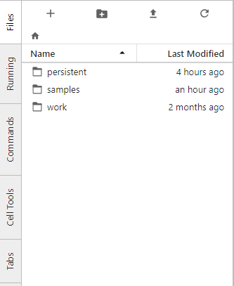
EGI features: Persistency
Persistent directory linked from home
User decides what to keep
NFS storage

Slide 6
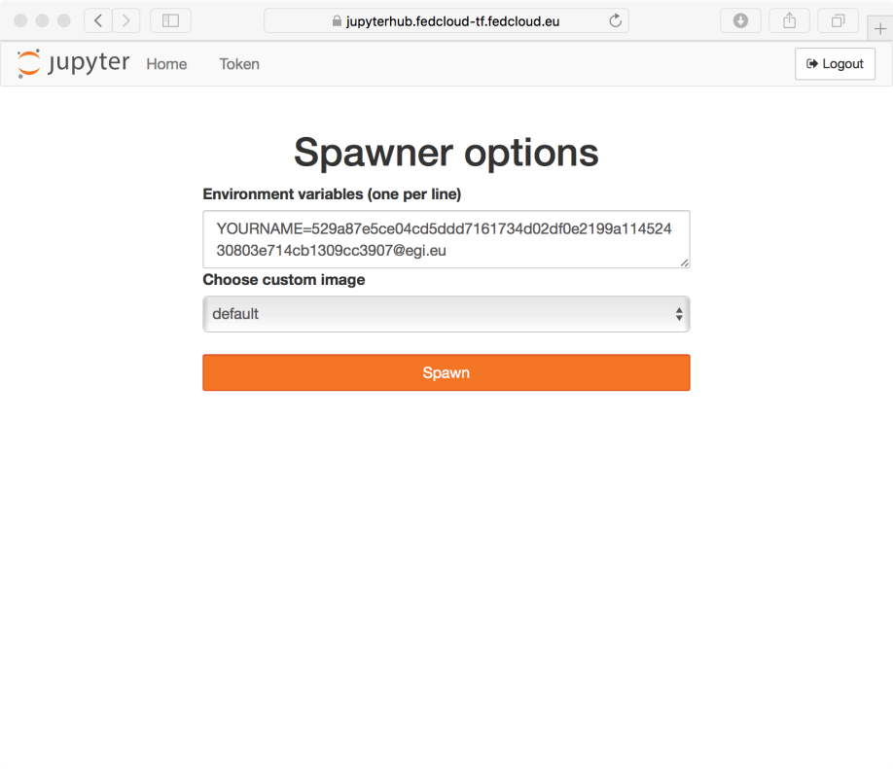
EGI features: Custom Kernels
Easy to extend with your own kernels
Docker container image with JupyterHub v0.8
No root user
Uses $HOME for notebooks
User select what to start when creating their notebooks

Slide 7
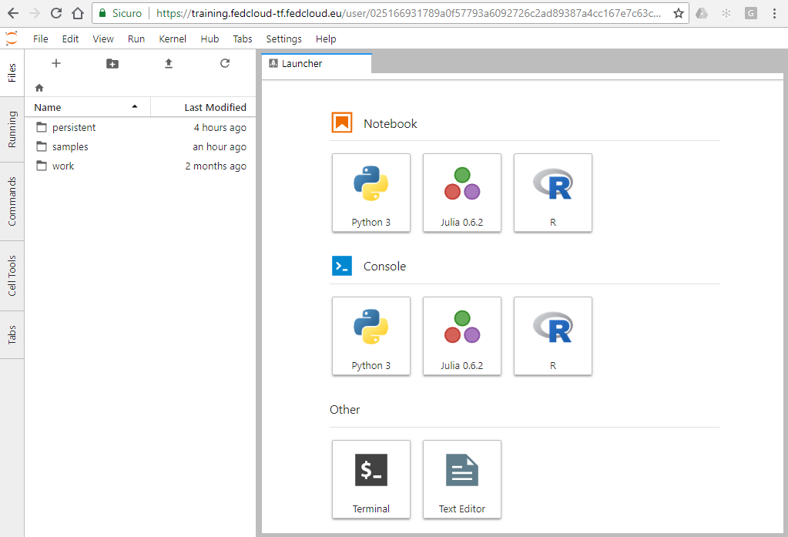
The Jupyter Notebook panel

Slide 8
EGI Notebooks: Service modes
Catch-all / The EGI Applications on Demand (AoD)
Available via the marketplace
Limited resources (computing + storage), sponsored access
Kills notebooks after 1 hour of inactivity
VO/Community deployment
Tailored to specific VO with custom computing/storage:
access to GPUs, fat nodes
access to Spark, other BigData/ML environments
auto-mount filesystems on notebooks

Slide 9


EGI Notebooks: Technology stack
EGI Check-in
EGI ARGO
EGI Accounting
Kubernetes Cluster (EGI Cloud Container Compute)
Notebooks Monitoring
Notebooks Accounting
SSL Certificate
Notebooks persistent storage
Kubernetes
Ingress
User sessions
k8s pvc
Oauthenticator
KubeSpawner
https://notebooks.egi.eu

Slide 10
EGI Notebooks, next steps

Slide 11
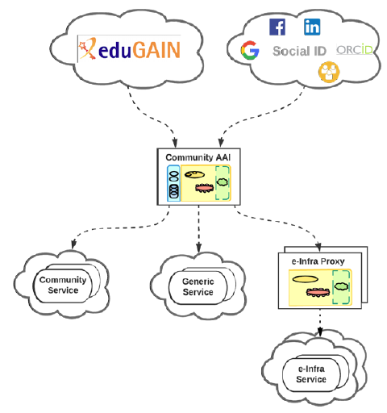



The Community first approach

Slide 12
Definitions
Community AAI:
An AAI service that enables the use and management of community identities for access to resources.
e-Infrastructure Proxy:
An AAI service of an e-Infrastructure that enables access to resources offered by Service Providers connected to the e-Infrastructure.
AAI service:
A service that enables authentication and authorised access to resources
Community service:
A service provided to members of a specific community.
Generic service:
A service provided to members of different communities.
e-Infrastructure service:
A service provided by a generic e-Infrastructure to member of different communities.

Slide 13
Links
JupyterHub tutorial
Documentation of JupyterHub | PDF (latest)
Documentation of JupyterHub’s REST API
Project Jupyter website
The EGI Jupyter notebook | wiki
Webinar on EGI Notebooks - March, 19 at 15:00 CET
https://indico.egi.eu/indico/event/4537/

